Slide 1
What is Dot Net
Created by Abdul Rub

Slide 2
Microsoft Visual Studio Dot Net
Dot net is a Product of Microsoft Announce by Bill gates(2002).
MS VS.net released in 2002.
Its Dot net a language ?
Platform to develop (S/W app).
(.NET language + .NET Technology.
Combination of These Two is A Complete S/W application.
.NET is not a language, it's a Technology to Develop a software and website using IDE Microsoft Visual Studio. Once we installed MSVS we able to get .NET component and framework

Slide 3
What is .NET Framework
Framework
Architecture
.NET Language (80+)
.NET Technology
Base Class Library
.NET Execution Engine (CLR)
System Name is the father of all the Classes and we can call as a Base class Library
Layer1 | VB,C#,F#,VC++,F#,J#,VJC#, etc…
Layer2 | Asp.net,Windows,Console,WCF,API,etc…
Layer3 | ADO.NET/XML
Layer4 | Base Class Library (BCL) (DLL) FCL.
Layer5 | Execution Engine (CLR)
Layer6 | OS (32 bit 64 bit)
BCL
Collection of Classes
Class and Object
Predefine
Microsoft Introduce which means made by Microsoft its come when we install MSVS
User Define
Created by User which attach in the Project
System.Object (Base Class)
Re-Use

Slide 4
Need to Install on The System
S/W App
Widows Form(Technology)
C# (Language)
Web App
Asp. Net (Technology)
C# (Language)
Billing Software (Reliance Mall)
Require Web Server
www.gmail.com,www.facebook.com

Slide 5
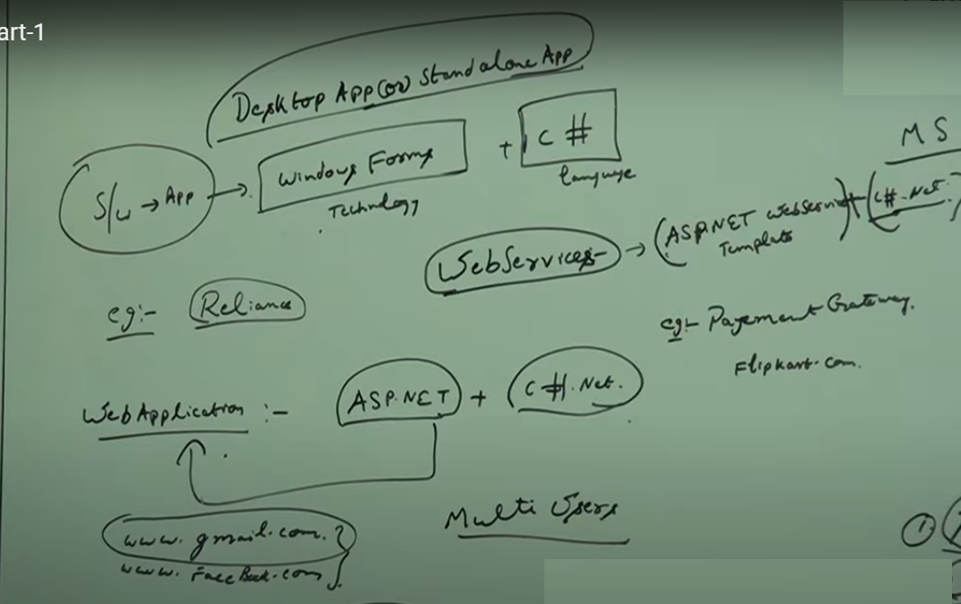

Slide 6
How .NET Code is working Internally
CLR
C#
CSC
MSIL
Code
JIT Compiler
Native Code/Byte Code
O/S
VB
VBC
Step 2
Step 1

Slide 7
Version of .NET (Visual Studio) | Framework
2002 | 1.1
2003 | 2.0
2005 | 3.0
2008 | 3.5
2010 | 4.0
2012 | 4.5
2013 | 5.0
2016 | Core 1.0-1.1
2017-2018 | Core 2.0-2.1
2019-2020 | Core 3.0.3-5.0
2021-2022 | Core 6.0-7.0

Slide 8
1:- C# .NET is case sensitive. Example:- int a; A=8//give Error a=8 //its correct 2:- Block level Programing Example:- { //Code Here } 3:- Every statement should be terminated using Semicolon (;).
.Net Language Feature (C#)

Slide 9
Executable File : In C lang. In .Net lang. first.c first.cs Compile Compile tcc first.c csc first.cs first.exe first.exe

Slide 10
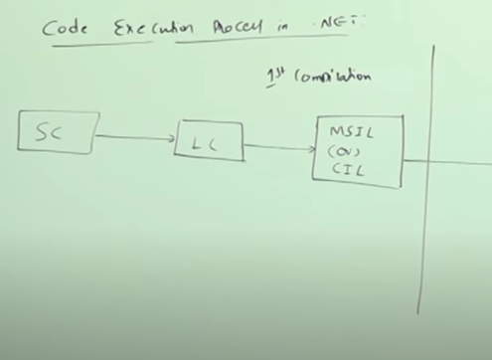
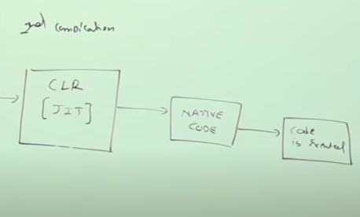
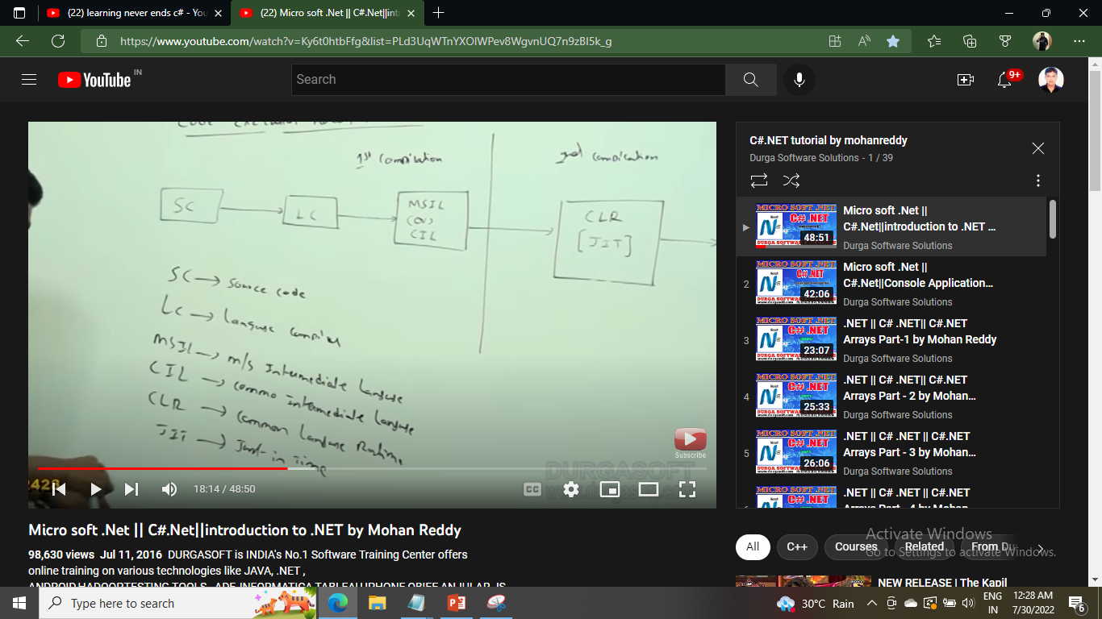

Slide 11
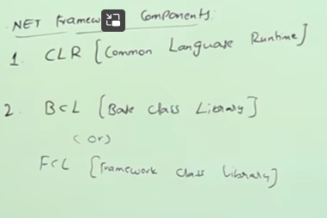

Slide 12
End of Introduction

